Slide 1
Tracking Water Quality Across China
By: Julien Smith
Updated 6/20/2025

Slide 2
What is our goal?

Slide 3
Executive Summary
Business task:
Analyze water quality data from 2023 to identify which regions in China experienced the highest pollution levels, detect seasonal trends in pollution, and highlight which pollutants were most frequently elevated.
Key factors:
This dataset was synthetically generated and does not reflect real-world data. It is meant for exploratory analysis only.
Station names, coordinates, and measurements are entirely fictional and were algorithmically randomized within realistic boundaries.
Heavy metals such as lead, cadmium and mercury were excluded from the analysis. Instead, this study focuses only on organic pollutants.

Slide 4
Pollutant Overview

Slide 5
Pollutant Description Significance
Dissolved Oxygen | Presence of Oxygen gas in water | Vital for aquatic life to breathe properly
Turbidity | Measure of haziness of water due to suspended particles | Lowers oxygen and facilitates the growth of bacteria / pathogens
Ammonia | Caused by agricultural runoff and natural processes | Contributes to Eutrophication
Phosphorous | Caused by agricultural runoff and erosion | Contributes to Eutrophication
Nitrate | Excess in nutrients frequently caused by chemical waste runoff | Contributes to Eutrophication
Nitrite | Caused by agricultural runoff, sewage, and natural processes. | Toxic to marine life, interferes with oxygen transport in the bloodstream
Total Nitrogen | The sum of compounds carrying nitrogen | Contributes to Eutrophication
Eutrophication:
Increased nutrient levels causing excessive algae and plant growth, suffocating marine life.
Natural processes:
Includes factors such as organic decomposition or marine activity.
Compounds carrying nitrogen:
Nitrite
Nitrate
Ammonia

Slide 6
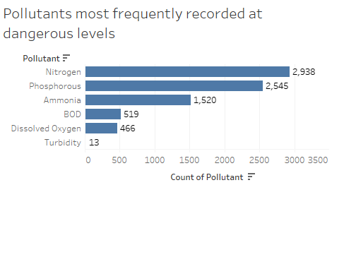
Which pollutants were most elevated?
Nitrate, Nitrite, and COD are excluded as none of these pollutants reached high / very high levels of contamination.
Nitrogen, Phosphorous, and Ammonia had the highest number of instances where pollution reached unsafe levels.
All 3 of these pollutants directly contribute to Eutrophication.
Turbidity remained relatively low, showcasing how clear water is not indicative of safety
For an more detailed perspective:
check out a interactive map here

Slide 7
Which provinces faced the most pollution?

Slide 8
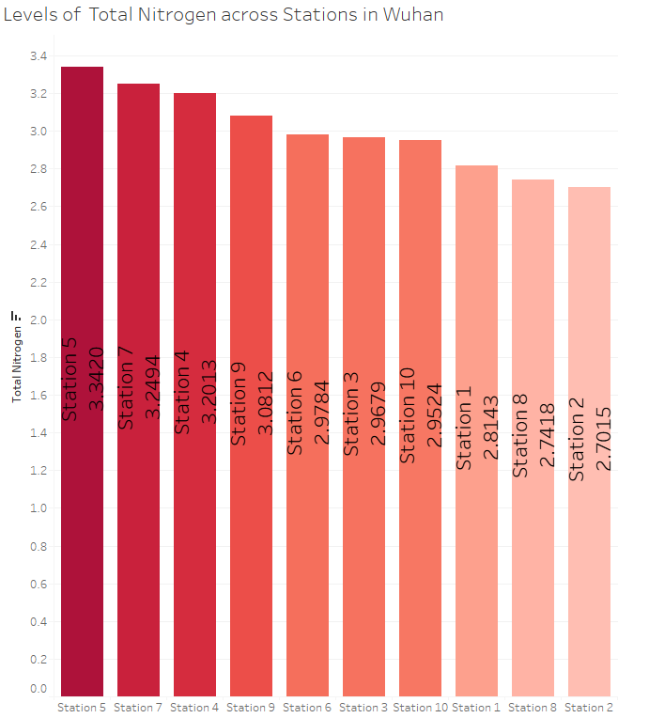
Wuhan had 6 different stations rank within the top 15 across all three pollutants - the highest of any city.
Additionally, Station 5 appeared twice, for both Nitrogen and Phosphorous.
Average levels of Nitrogen were moderately raised across many other provinces as well.
View interactive bar chart here

Slide 9
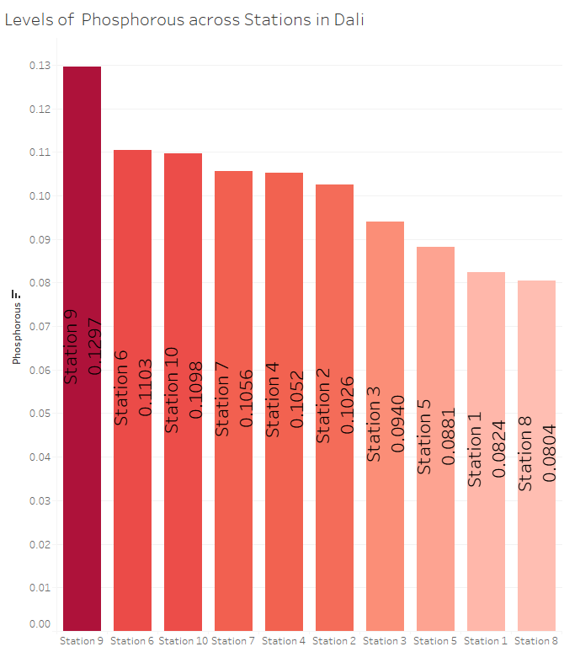
Dali had 3 stations rank in the top 15 between both Ammonia and Phosphorous.
Station 9 appeared in both categories, ranking 2nd for Ammonia and 6th for Phosphorous, revealing multi-pollutant contamination.

Slide 10
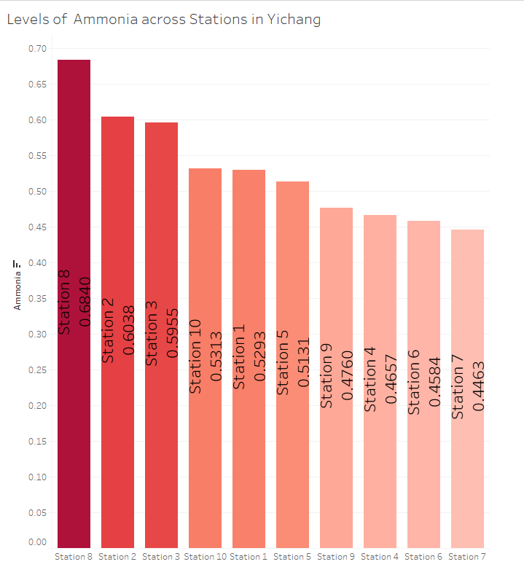
Yichang had 4 stations rank among the top 15 across Ammonia, Phosphorous, and Nitrogen.
Station 8 in particular consisted of the highest average levels of Ammonia.
Luoyang and Zhengzhou were among the other provinces which had 4 or more stations rank among the top 15.

Slide 11
Which pollutants spiked seasonally?

Slide 12
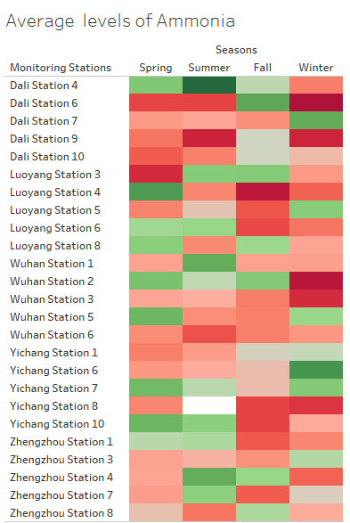
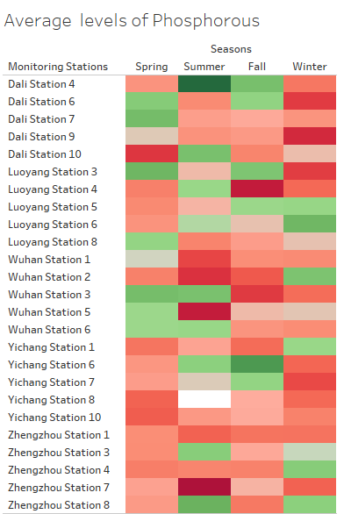
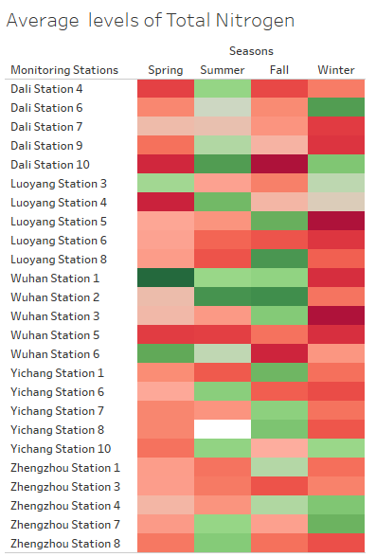
* Station 8 in Yichang was missing pollutant data during the summer.
All 3 Pollutants were elevated across most stations between Winter and Spring.
Summer and Fall had more variance regarding levels of pollution.
.

Slide 13
Key takeaways

Slide 14
Findings
Wuhan was among one of the most polluted provinces across China, followed by Dali, Yichang, Zhengzhou and Luoyang (in no particular order)
Spring and Winter tended to have higher pollutant levels, while Summer showed the least severe averages across most stations.
Nitrogen levels were relatively stable among many stations within Wuhan, Luoyang, and Yichang during Fall, yet spiked sharply in Winter.
Stations within Zhengzhou and Yichang had high levels of Phosphorous nearly year round; similarly, stations in Dali exhibited consistently high levels of Ammonia.
Monitoring is highly recommended in these 5 provinces, as they consistently exhibited elevated pollution levels across all three contaminants.

Slide 15
Thank you

